Slide 1


Fudge Inc. Product Popularity
Team 3
Aurelia Arnett, Rebecca Burnett, Ava Nelson

Slide 2
Introduction
Fudgemart: an online retailer that sells general purpose goods to customers
Contains customers, products, and shipping vendors
Fudgeflix: an online movies and tv show streaming on-demand service
Contains accounts, subscriptions, and video titles
Business Case: Both companies require the ability to analyze their product popularity to optimize which products prioritize carrying and which products to consider getting rid of

Slide 3
Business Case
Which products & product types (genre or department) generate the most interest? (based on customer rating)
To understand the customer need
To improve customer experiences when purchasing products from Fudge Inc.
To streamline the process for customers to use Fudge Inc. products
To optimize the data/product warehouse by increasing stock of popular products and reducing non-popular products

Slide 4
Project Overview
Objective: Merge two companies to enhance the overall customer experience
Goal: To understand which products drive the highest popularity, based on customer reviews

Slide 5
Mapping
FudgePopularity | Fudgemart | Fudgeflix
Customer | Customers | Accounts
Product | Products | Titles
Product Type | Department | Genre
Customer Rating | review_stars | at_rating
Assumptions:
Customers rate products on a scale from 1-5, where 1 indicates lowest satisfaction and 5 indicates highest
Returned date in Fudgeflix indicates the date when the customer reviewed the title

Slide 6
Tools used
ROLAP: SQL Server to build the data warehouse foundation
SSIS: Microsoft Visual Studios to process the ETL
Visualization: Microsoft Power BI to create visualizations and dashboards for executive decisions

Slide 7
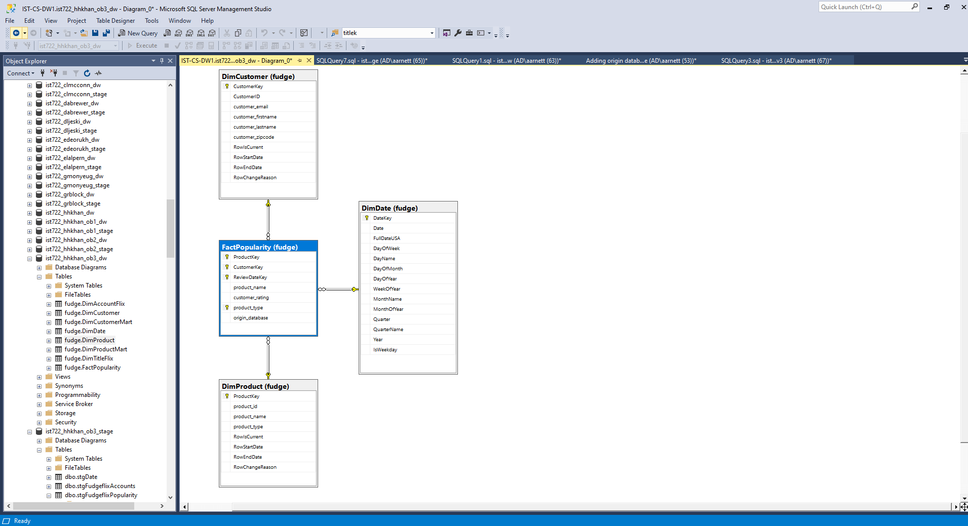
Star Schema
Product Popularity
SELECT fm_products.product_department, fm_products.product_name, fm_customer_product_reviews.review_stars, fm_customer_product_reviews.product_id, fm_customer_product_reviews.customerid, fm_customer_product_reviews.review_date
FROM fm_customer_product_reviews INNER JOIN fm_products ON fm_customer_product_reviews.product_id = fm_products.product_id

Slide 8
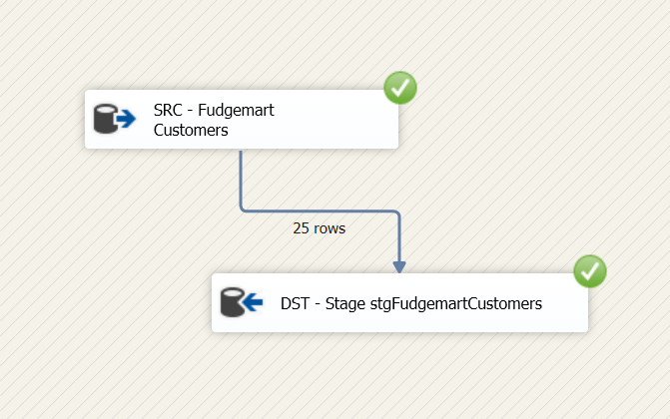
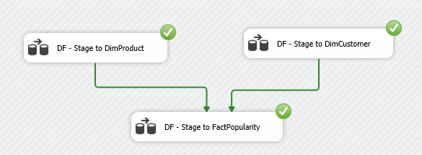
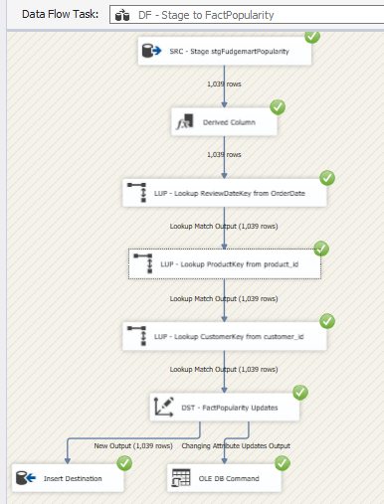
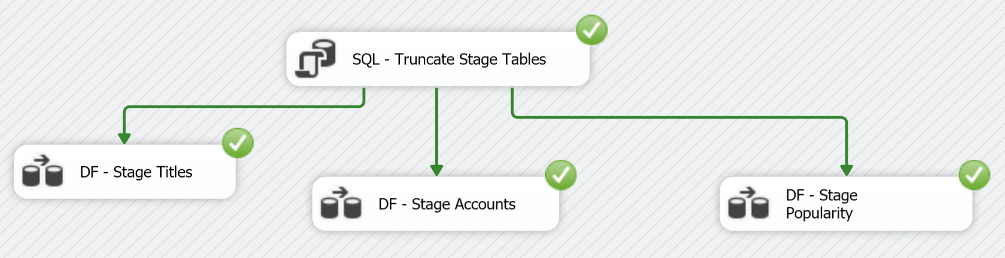
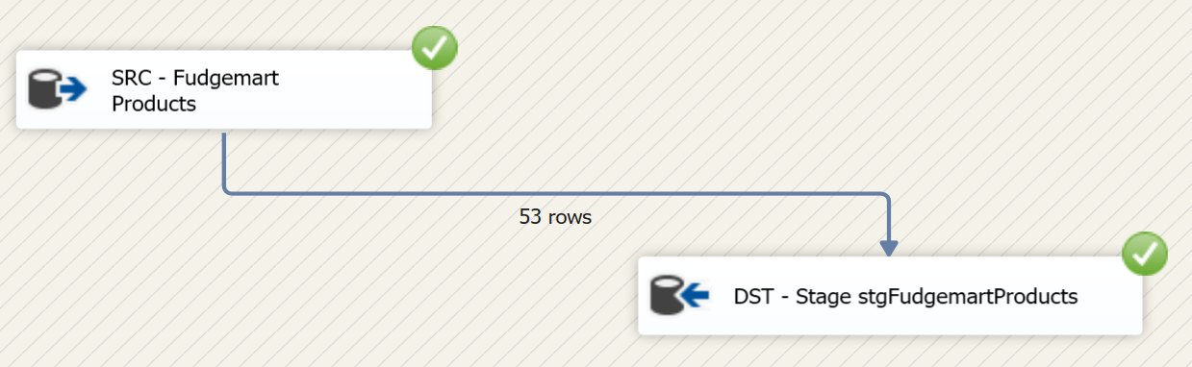
ETL Process

Slide 9
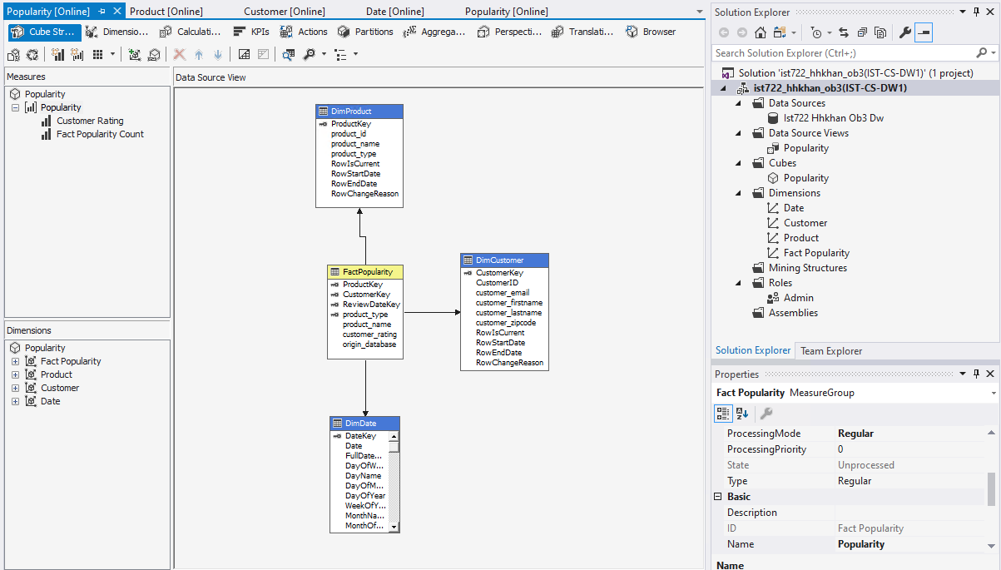
MOLAP/Cube Process

Slide 10
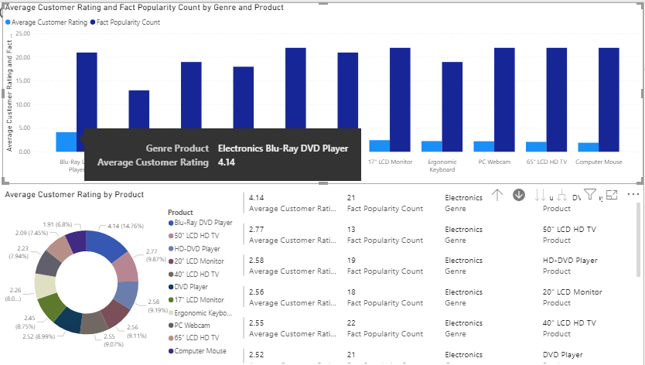
Business Intelligence
FudgeMart’s
Top Products:
1: Blu-Ray Player

Slide 11
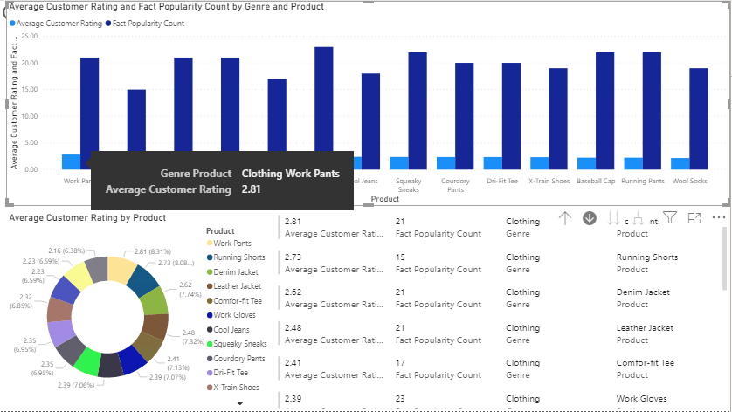
Business Intelligence
FudgeMart’s
Top Products:
1: Business Apparel

Slide 12
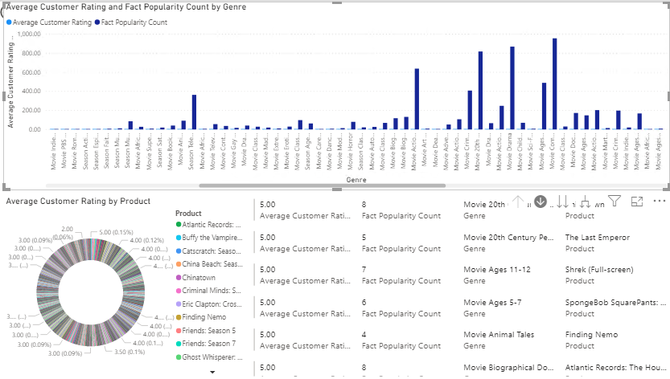
Business Intelligence
FudgeFlix’s
5 top genres:
-Season TV
-20th Century Period Movie
-Drama Movie
-Comedy Movie
-Action & Adventure Movie

Slide 13
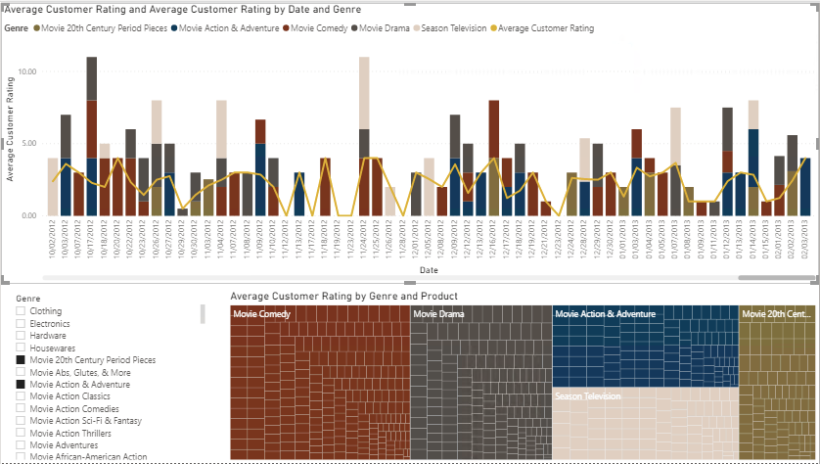
Business Intelligence
FudgeFlix’s
5 top genres:
-Season TV
-20th Century Period Movie
-Drama Movie
-Comedy Movie
-Action & Adventure Movie

Slide 14
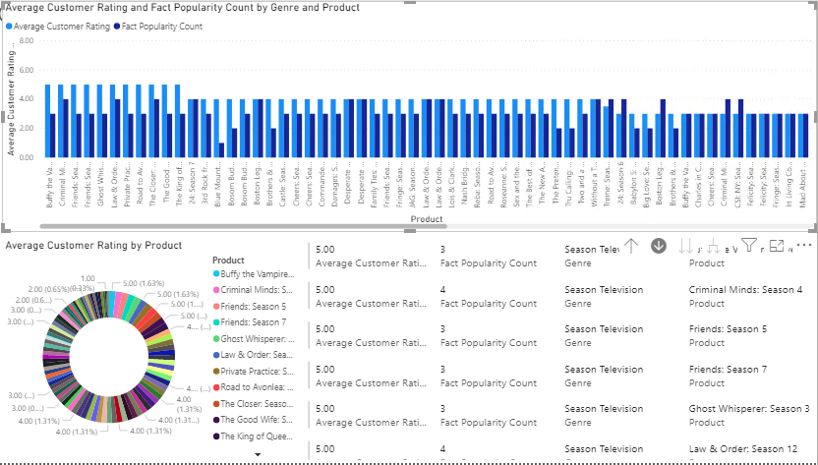
Business Intelligence
Season TV
-Highly Rated
-Often Rated
indicates higher viewership.
note top ranking shows (Buffy, Criminal Minds, Friends)

Slide 15
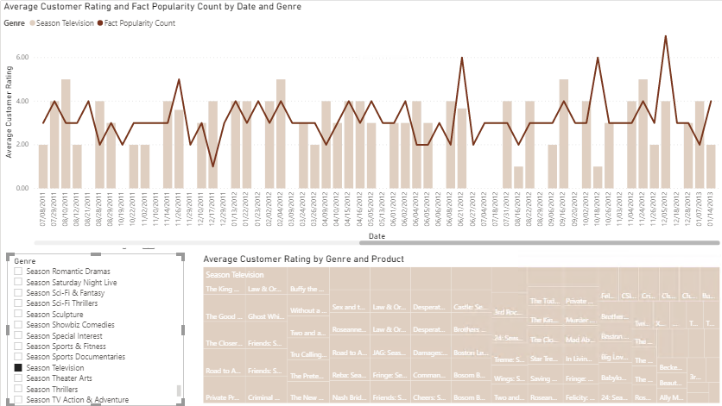
Business Intelligence
Season TV
-genre report over time
-shows rating distribution as well
Cue Demo

Slide 16
Recommendations
Fudgemart:
-Electronics and Clothing most popular.
-Improve selections elsewhere while expanding popular categories?
Fudgeflix:
-Season TV, 20th Century Dramas, Action & Adventure, Comedy, and Drama films carry most viewership/ratings.
-look into expanding selection due to consumer interest.

Slide 17
Appendix

Slide 18
Business Process Questions
How can we streamline costs?
What products generate the highest ROI?
Who are our most frequent customers?
Which titles and products generate the highest popularity?
What types of products generate the highest popularity?
How can we encourage purchase vs rental?
How do we determine competitive pricing?
Which geographies return the largest profit?

Slide 19
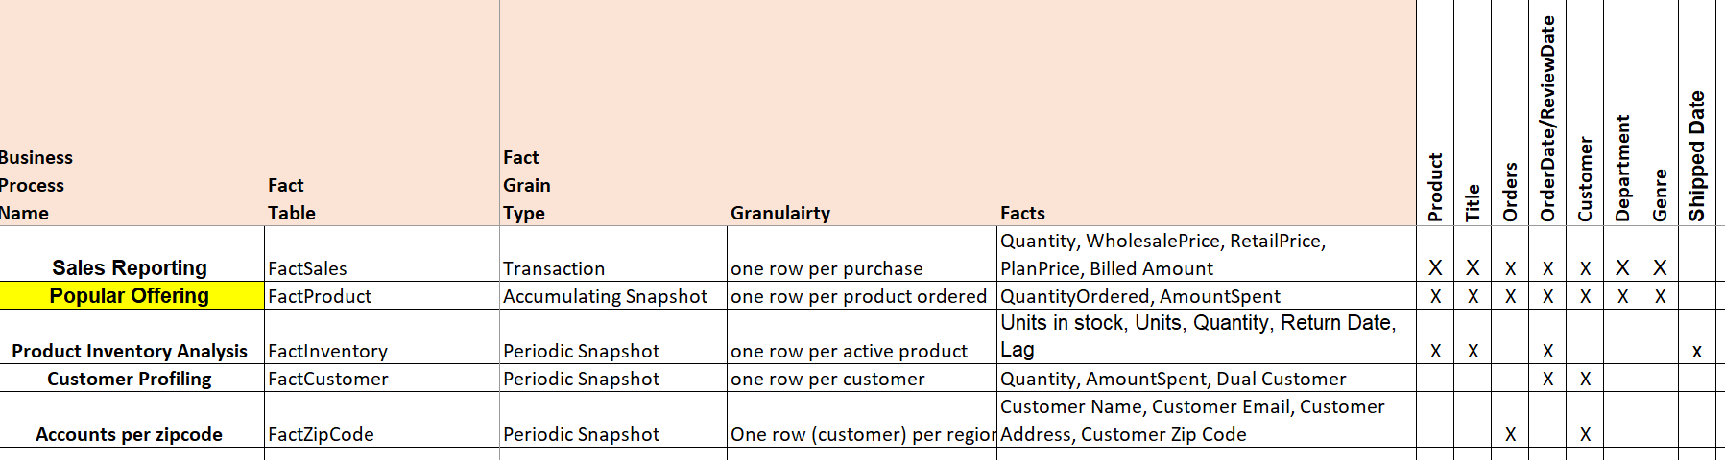
High Level Dimensional Model

